Slide 1
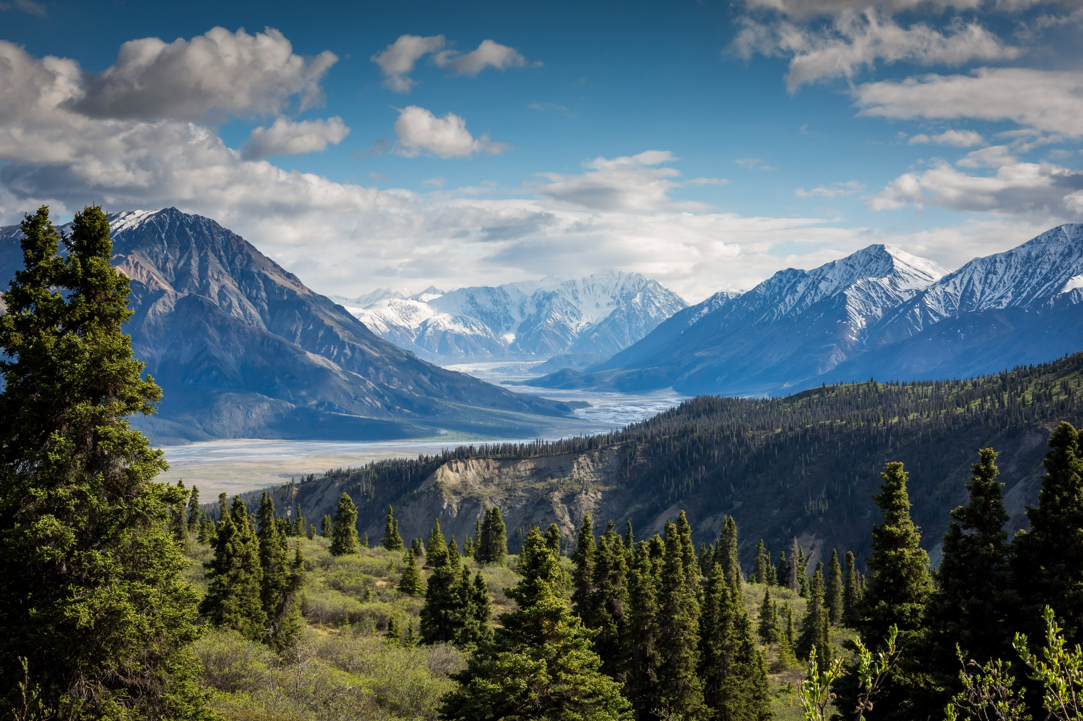
Components of biodiversity along altitudinal gradients
Photo by Kalen Emsley on Unsplash

Slide 2
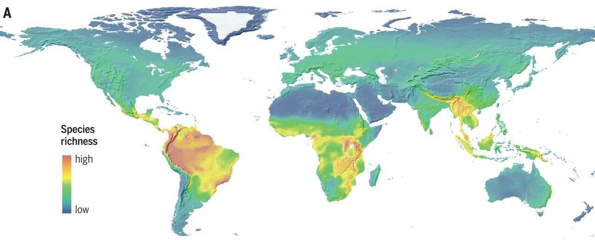
Why study biodiversity in mountains?
large environmental gradients in a relatively small geographical area
Biodiversity hotspots. “Mountain regions host roughly 87% of the world’s species of amphibians, birds, and mammals while constituting only around 25% of terrestrial land mass (excluding Antarctica)” (Rahbek, 2019)
High endemism
Refugia during periods of climate change
High speciation rates (e.g. due to fragmentation)
strongly affected by global changes
Species richness of birds, mammals, amphibians (Rahbek, 2019)

Slide 3
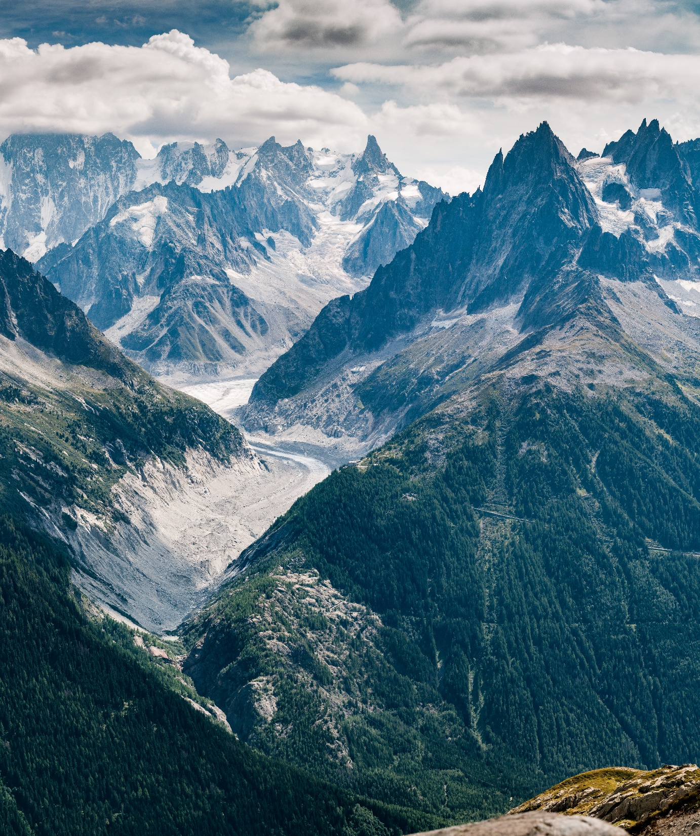
Altitudinal diversity gradients
Discuss
What are the ecological factors that vary along altitudinal gradients and influence biodiversity?
How does biodiversity change from low to high altitudes?
Photo by Simon Fitall on Unsplash

Slide 4
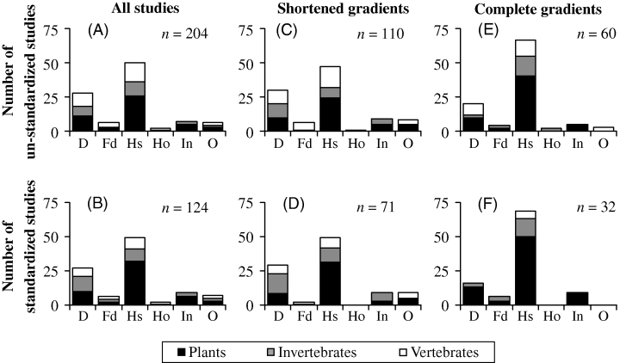
How does local species richness change with altitude?
Fd
Hs
D
In
Rahbek, 2005

Slide 5
How does species richness change with altitude?
Fd
Hs
D
In
Rahbek, 2005
Notes:
Percentage of published data sets showing various patterns of species richness and altitude: D, monotonically decreasing; Fd, flat- horizontal, then decreasing; Hs, hump-shaped; In, increasing; O, other. Top row includes all data sets (non-standardized). Bottom row includes only data sets judged to be standardized or with an attempt at standardization with regard to effect of area and sampling effort (standardized). Left column shows pattern for all studies, middle column only includes gradients with no data points below 500 m a.s.l. (shortened gradients), and right column only includes gradients with data points from £ 500 m to ‡ 2000 m a.s.l. (complete gradients).

Slide 6
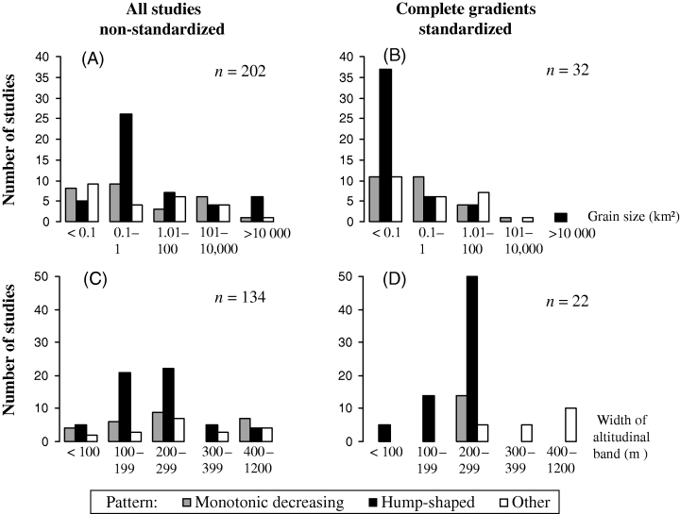
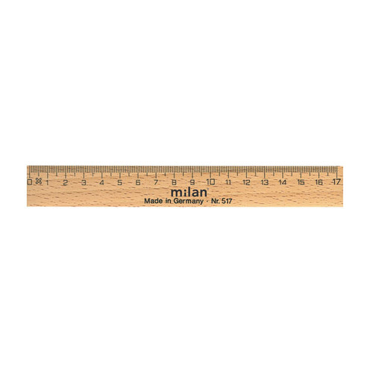
Scale-dependence
Grain
Extent
Rahbek, 2005
Notes:
Percentage of published data sets showing various patterns of the relationship between altitude and species richness at various grain sizes grouped by ‘grain size of sampling unit’ (top row) or by the width of the altitudinal bands used to sample the gradient (bottom row) for ‘all studies – non‐standardized’ and ‘complete gradients – standardized’, respectively (see Fig. 3 for definitions).

Slide 7
Components of biodiversity along altitudinal gradients
Rather than species richness at a single scale:
Changes in number of individuals
Changes in Species abundance distribution (SAD)
Changes in Intraspecific spatial aggregation
Requirement: abundance data with multiple samples per elevation

Slide 8

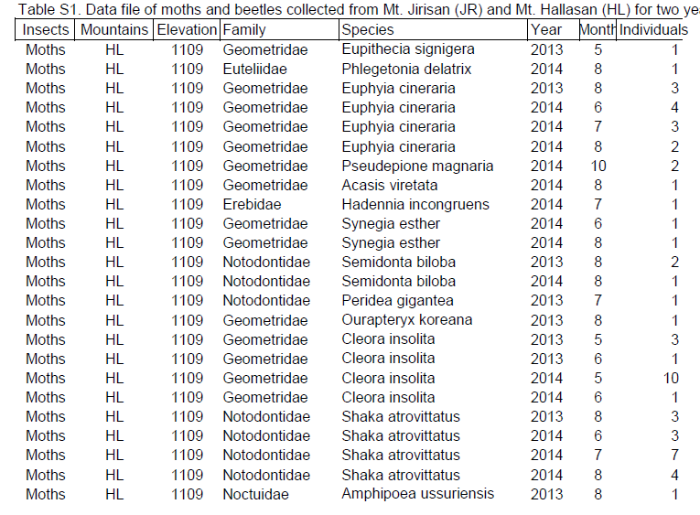
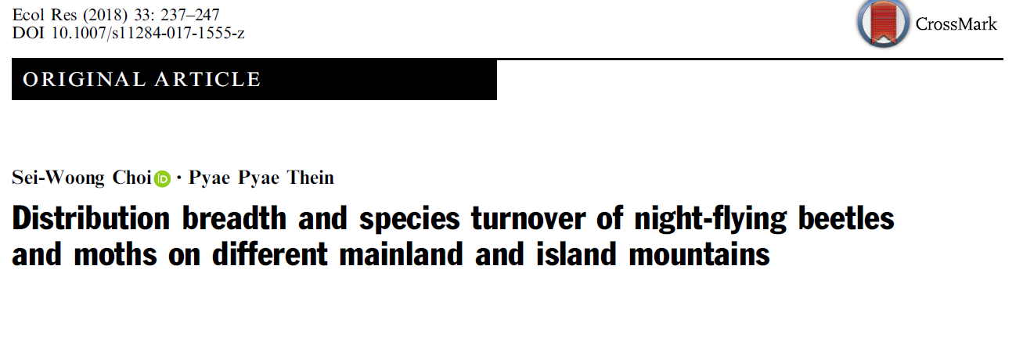
Extracting data from the literature
Analysis!

Slide 9

Reading time!
Read the Abstract, Introduction and the first part of the methods (i.e. Study area, Insect sampling…)
Where was the study done?
Which taxa?
Do they have altitudinal gradients?
How many samples?
Are there multiple samples per elevation (i.e. multiple scales)?
What was their question?
What was their hypothesis?
What did they find?
Photo by Ben White on Unsplash
Choi, S.‐W. and Thein, P.P. (2018), Distribution breadth and species turnover of night‐flying beetles and moths on different mainland and island mountains. Ecol. Res., 33: 237-247. doi:10.1007/s11284-017-1555-z

Slide 10
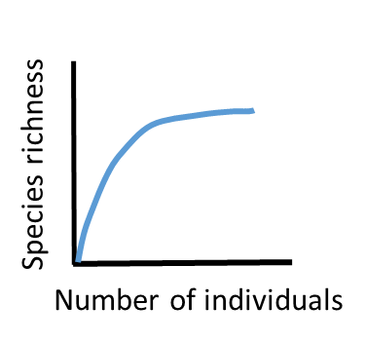
Hands on!
 | HL | JR
Moths | Choi2018_1 | Choi2018_3 | Moth team
Beetles | Choi2018_2 | Choi2018_4 | Beetle team
Draw individual-based rarefaction curves for each site in the dataset and color them by altitude. What can you observe?
Calculate number of individuals (N), observed richness (S_obs), rarefied richness (S_n) and S_PIE and examine their altitudinal trends.
Do the patters differ between mountains?

Slide 12
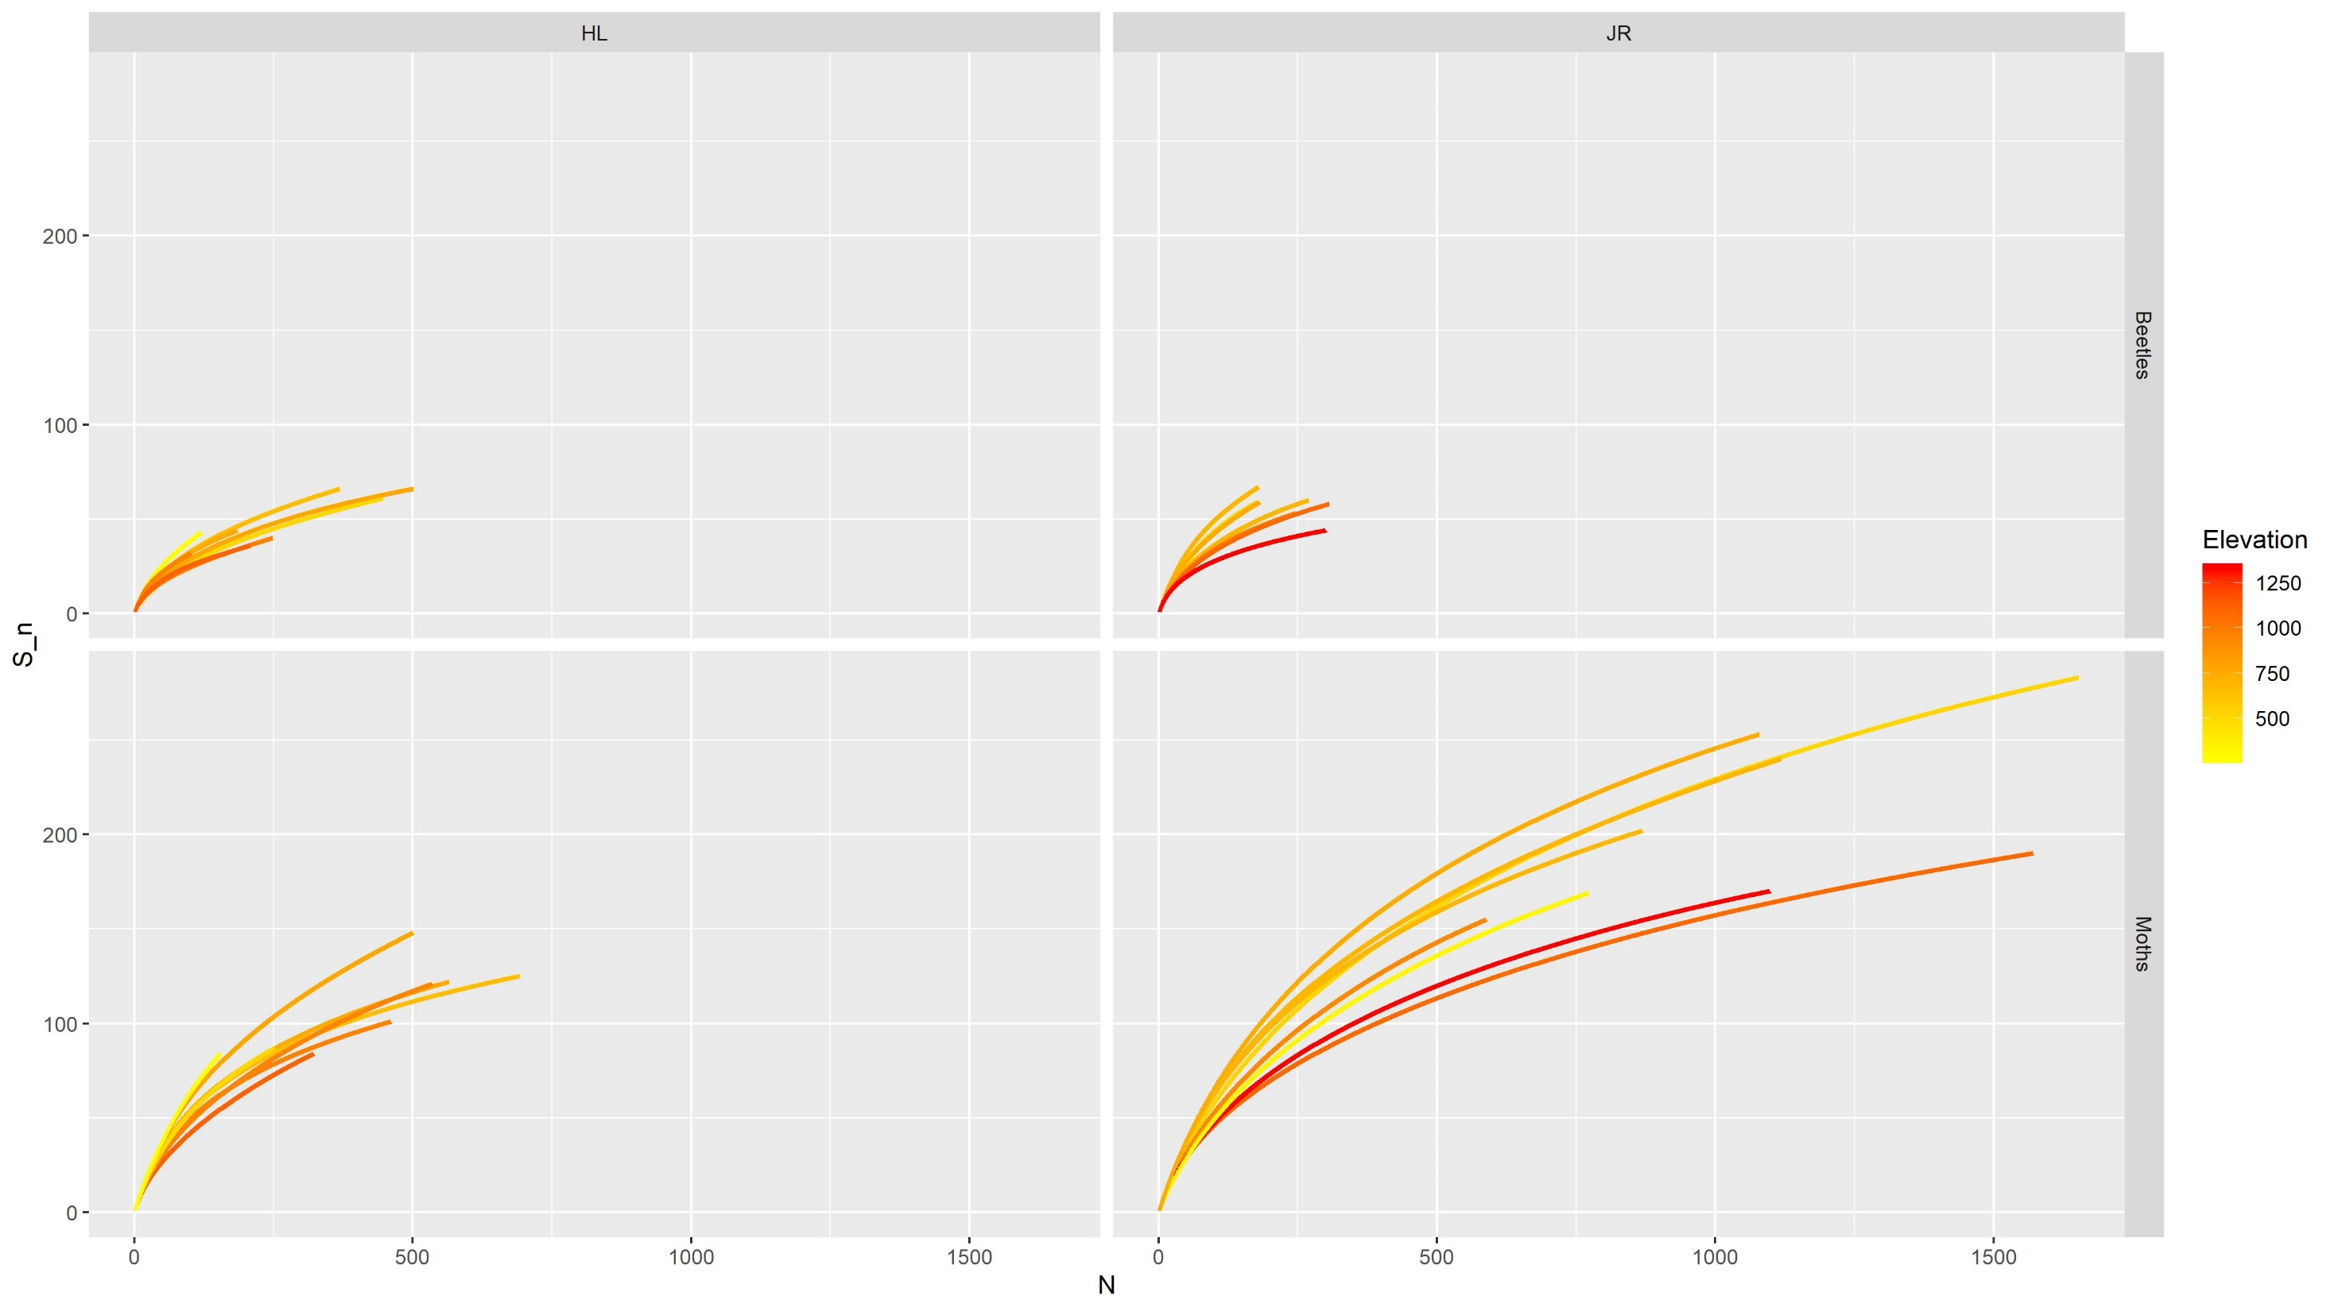

Slide 13
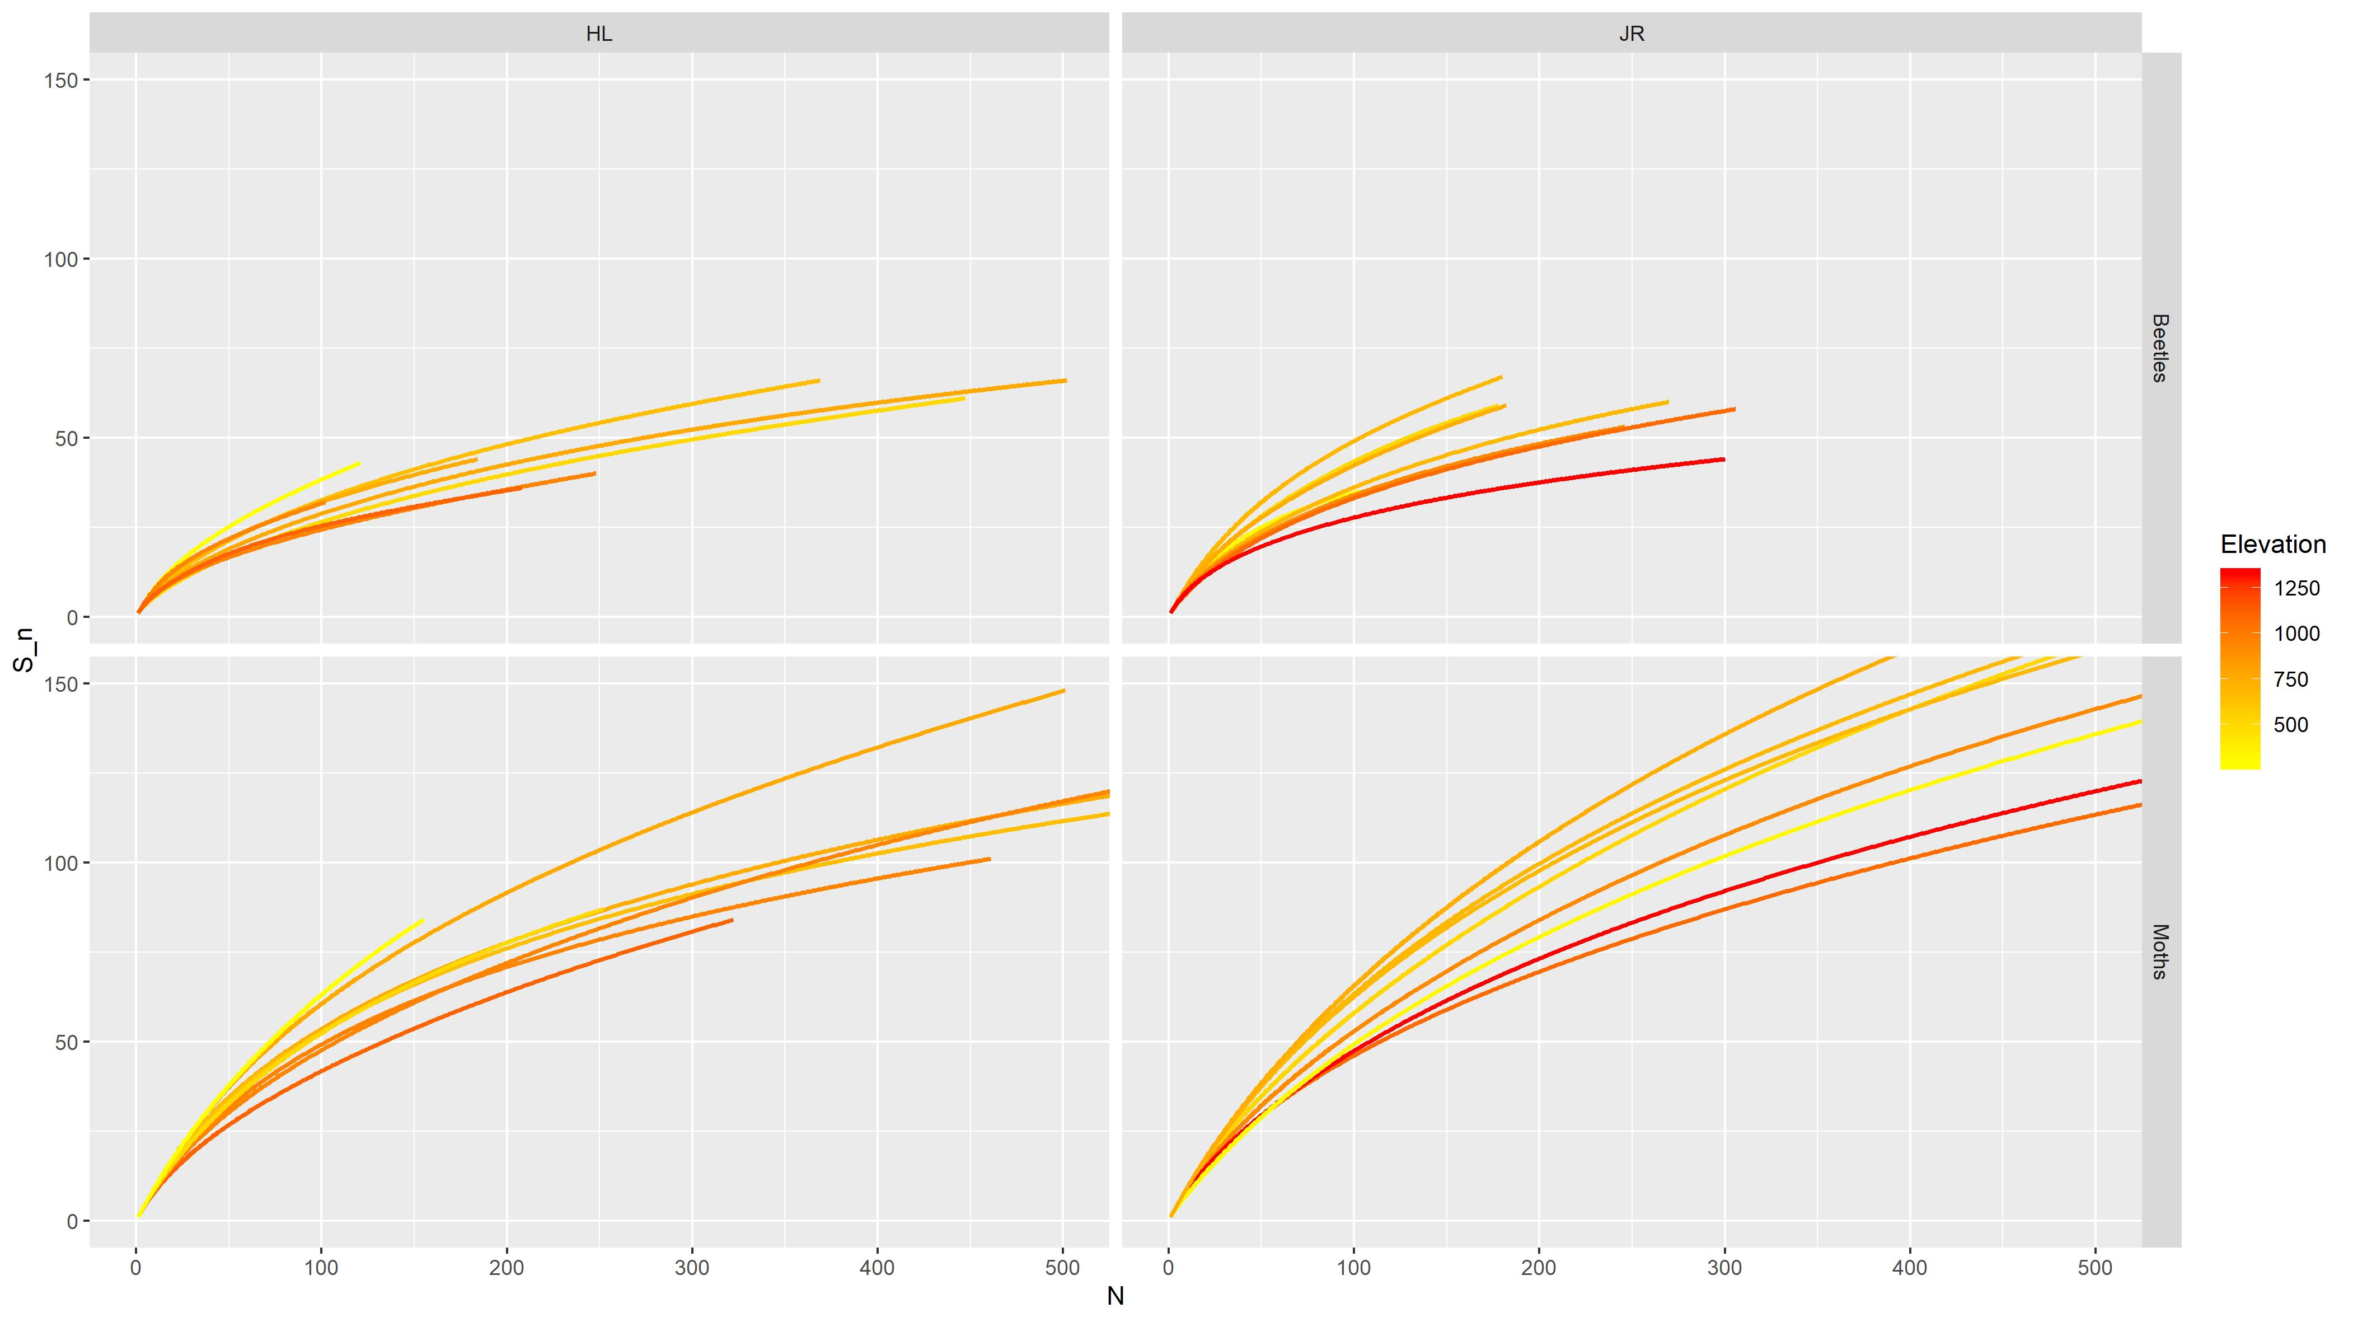

Slide 14
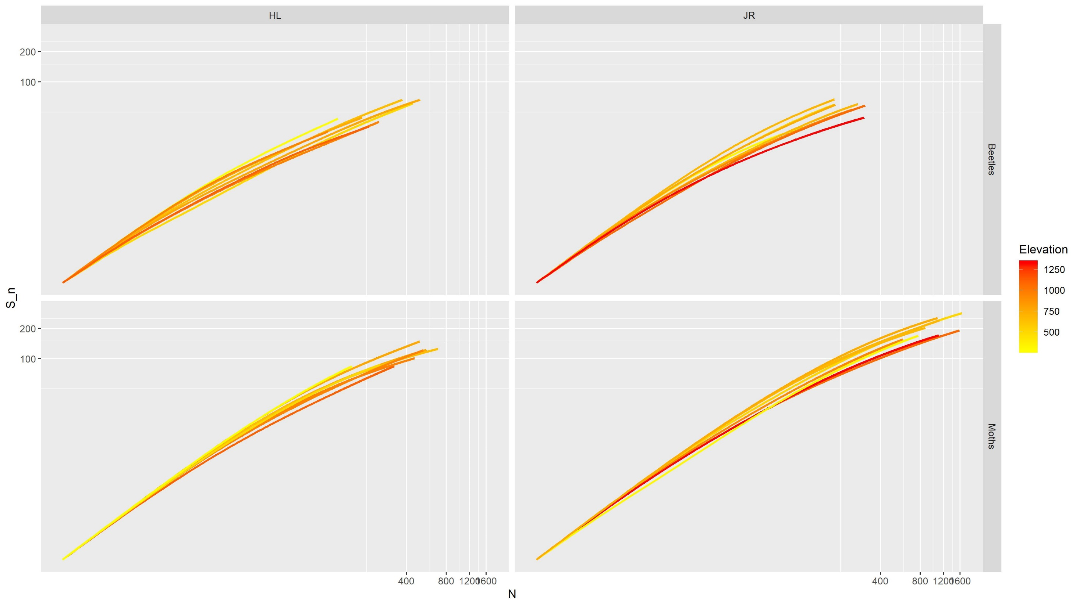

Slide 15
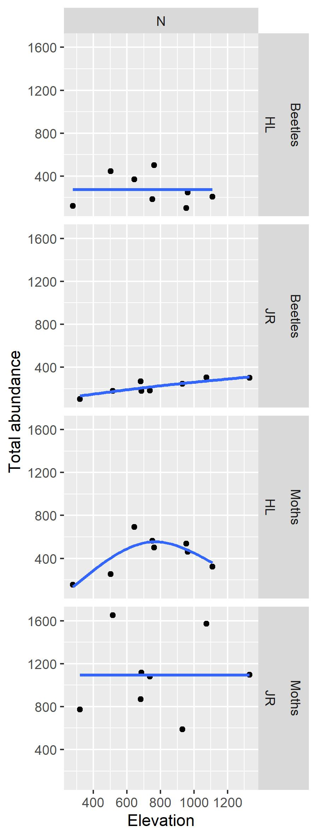
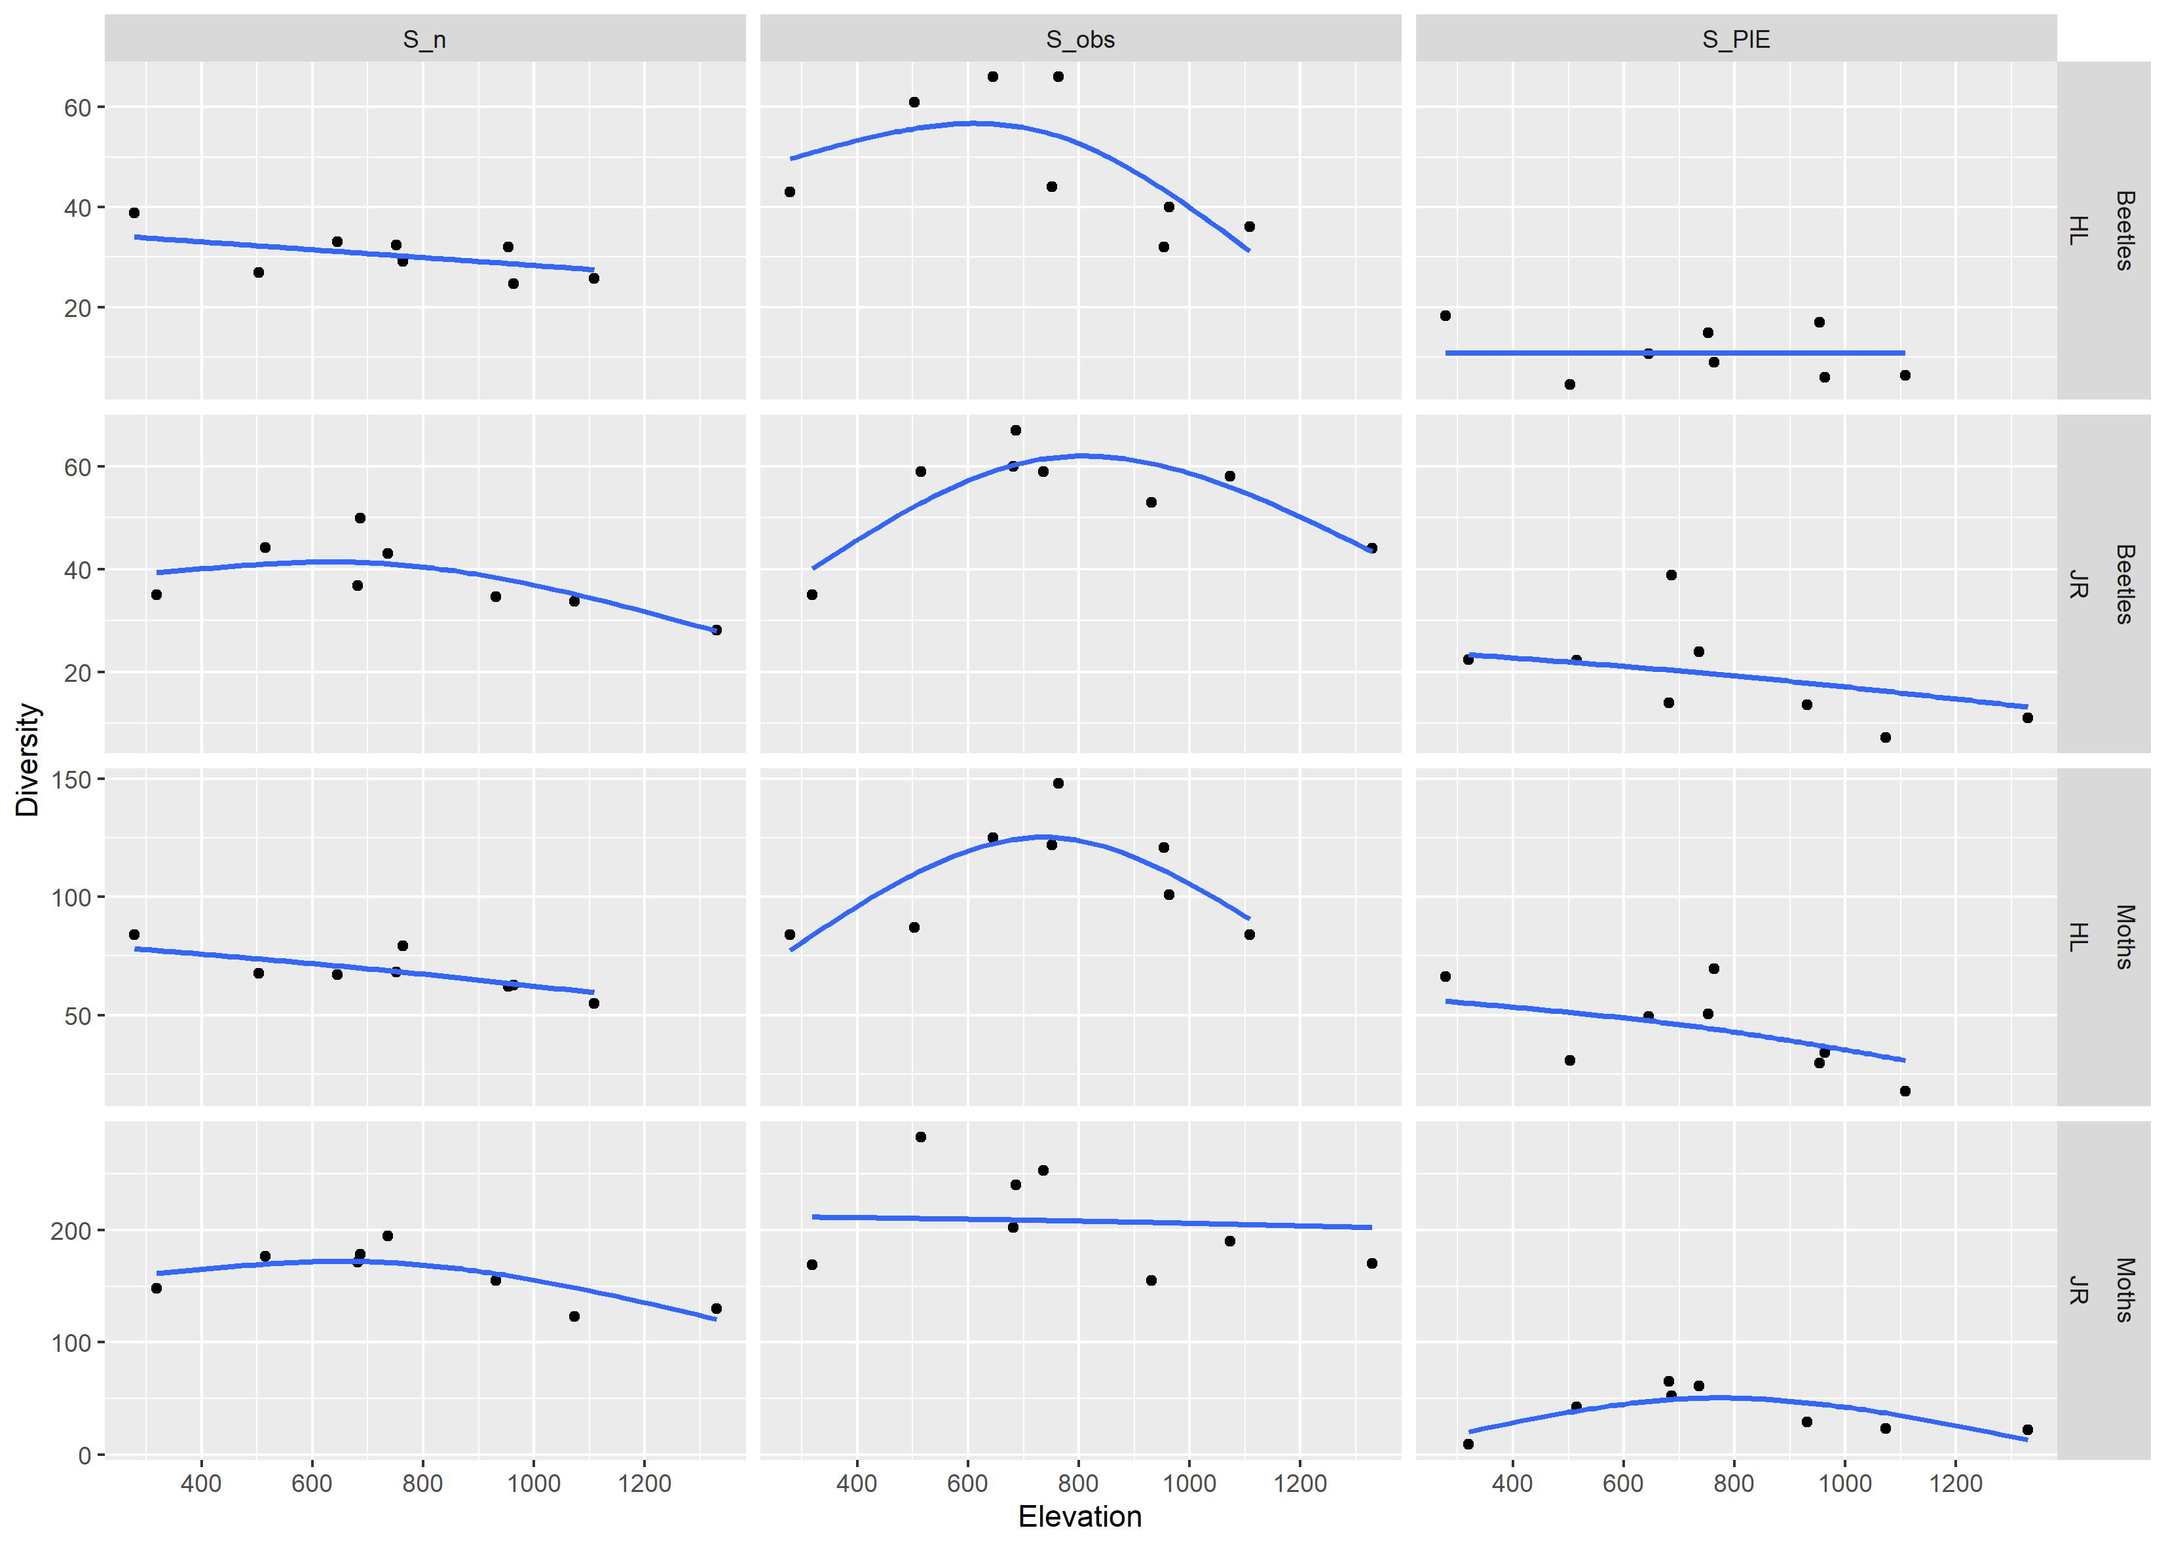

Slide 16
References
Rahbek, C. (2005). The role of spatial scale and the perception of large-scale species-richness patterns. Ecology Letters, 8(2), 224–239. https://doi.org/10.1111/j.1461-0248.2004.00701.x
Rahbek, C., Borregaard, M. K., Colwell, R. K., Dalsgaard, B., Holt, B. G., Morueta-Holme, N., ... & Fjeldså, J. (2019). Humboldt’s enigma: What causes global patterns of mountain biodiversity?. Science, 365(6458), 1108-1113.
Choi, S.‐W. and Thein, P.P. (2018), Distribution breadth and species turnover of night‐flying beetles and moths on different mainland and island mountains. Ecol. Res., 33: 237-247. doi:10.1007/s11284-017-1555-z

